Slide 1


PORTOFOLIO

Slide 2
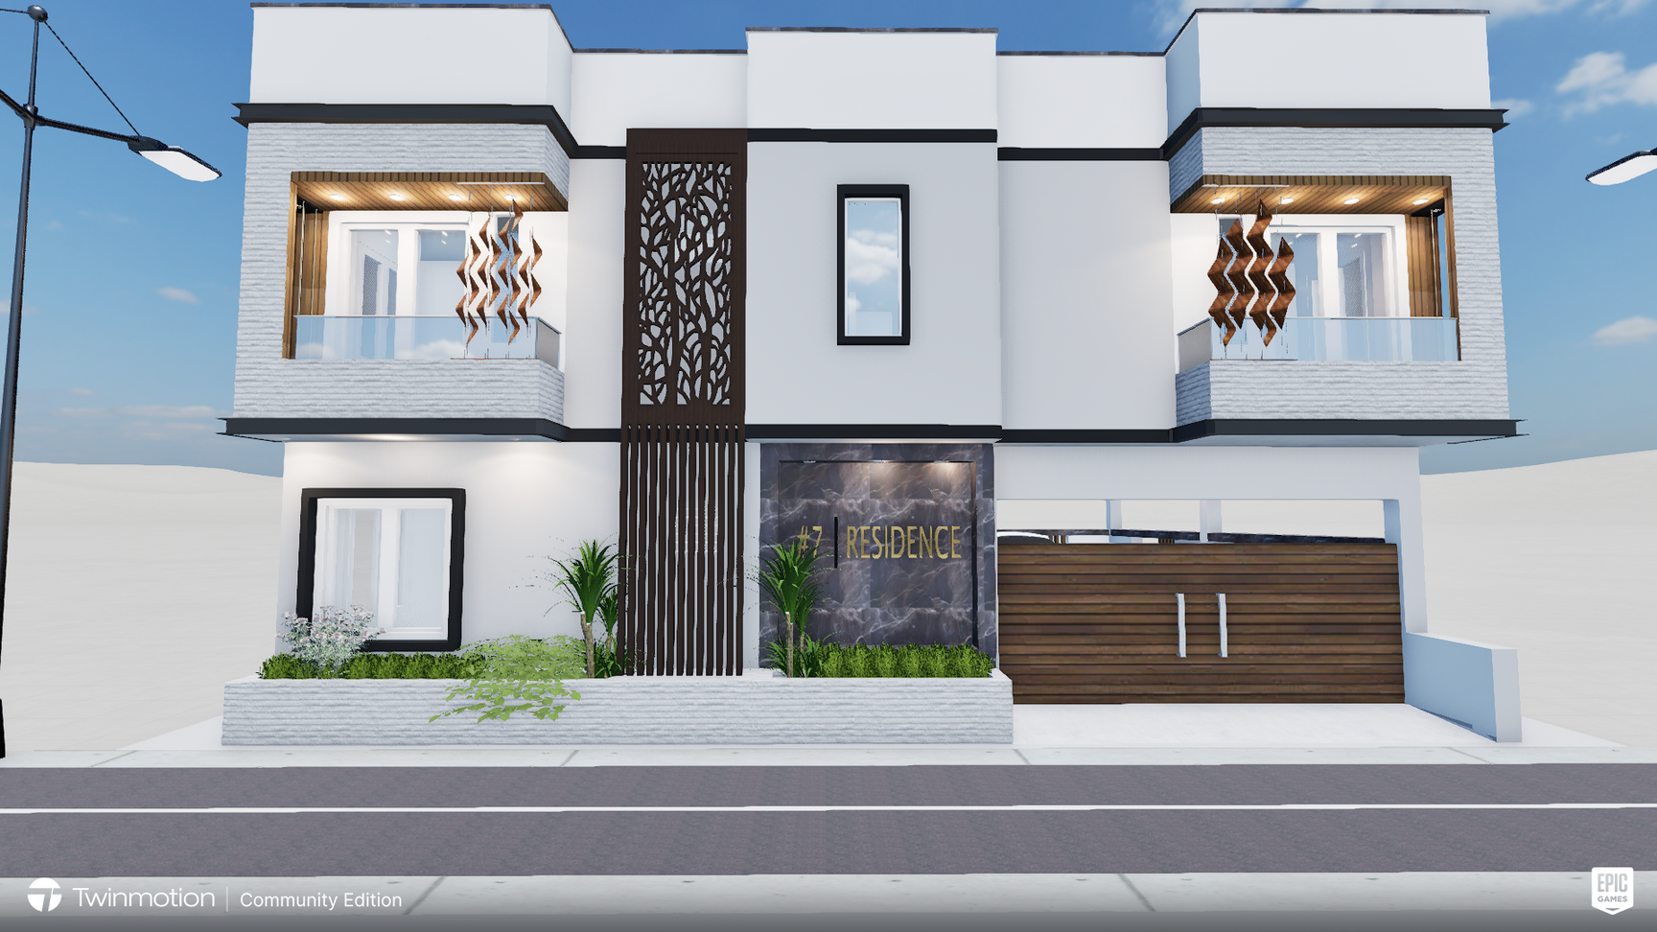
EXTERIOR ELEVATION
A 3BHK DUPLEX HOME
THIS PROJECT WAS CREATED USING SKETCHUP AND RENDERED USING TWINMOTION
FRONT VIEW
30.12.2023

Slide 3
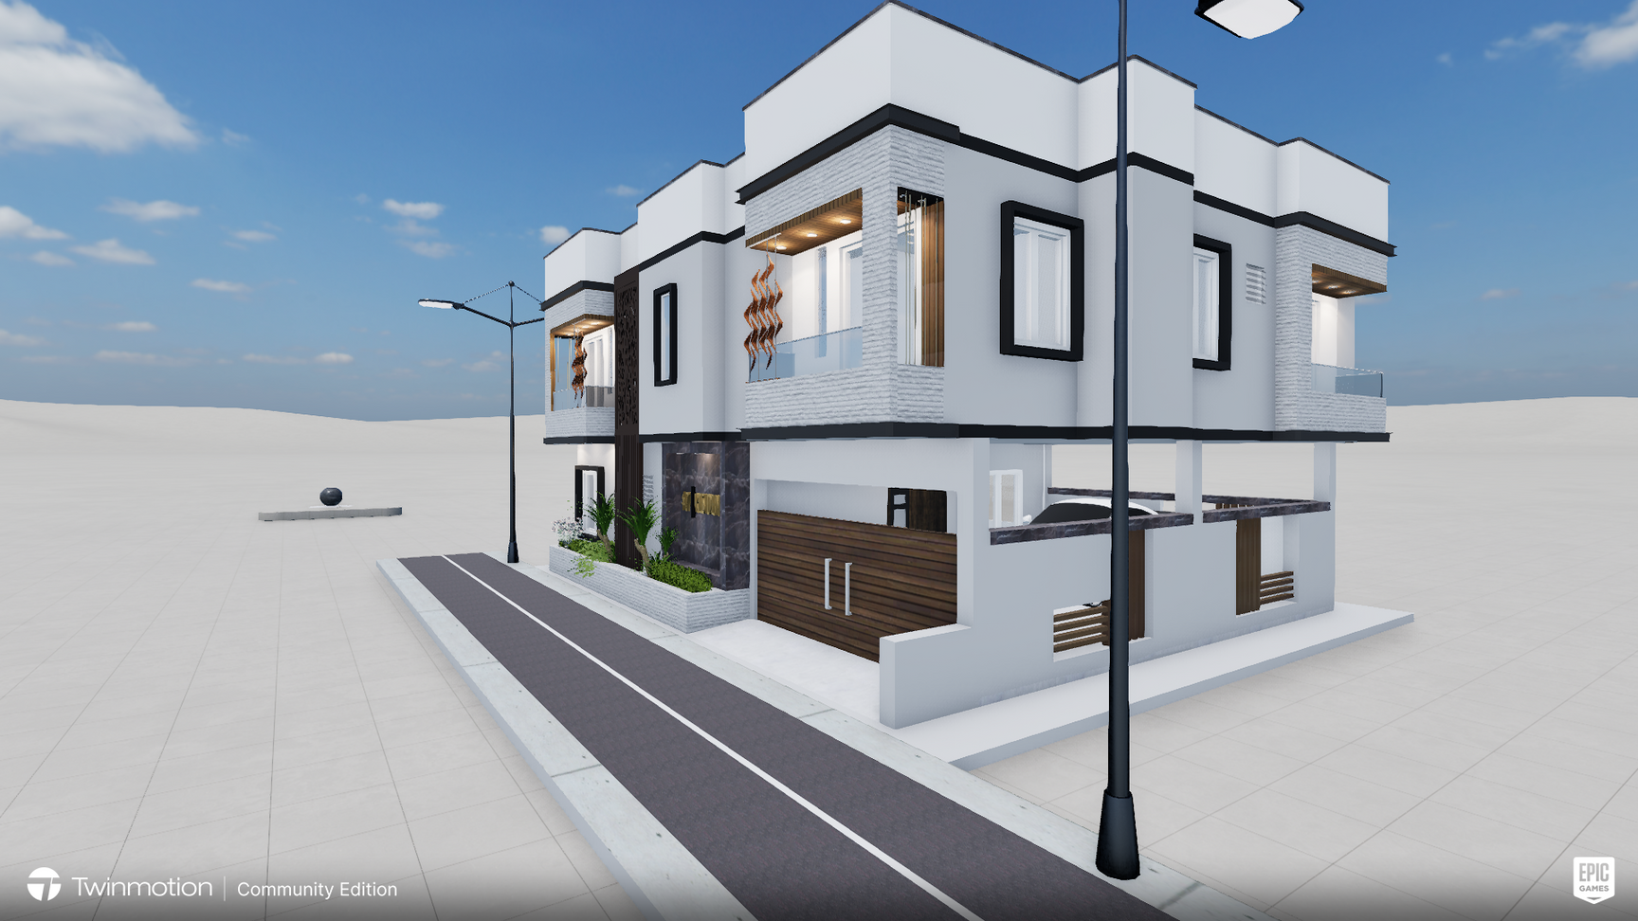
EXTERIOR ELEVATION
A 3BHK DUPLEX HOME
THIS PROJECT WAS CREATED USING SKETCHUP AND RENDERED USING TWINMOTION
ISO-VIEW
30.12.2023

Slide 4
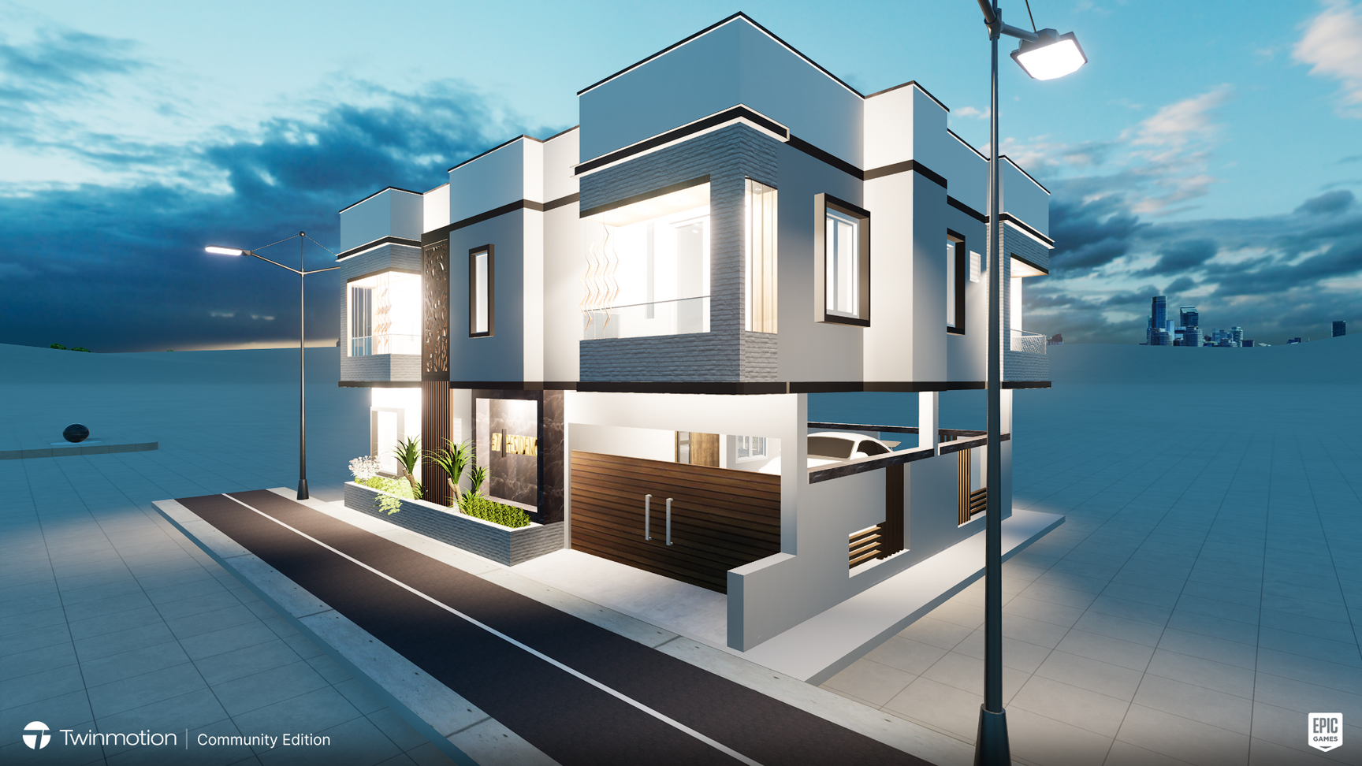
EXTERIOR ELEVATION
A 3BHK DUPLEX HOME
THIS PROJECT WAS CREATED USING SKETCHUP AND RENDERED USING TWINMOTION
ISO-VIEW
30.12.2023

Slide 5
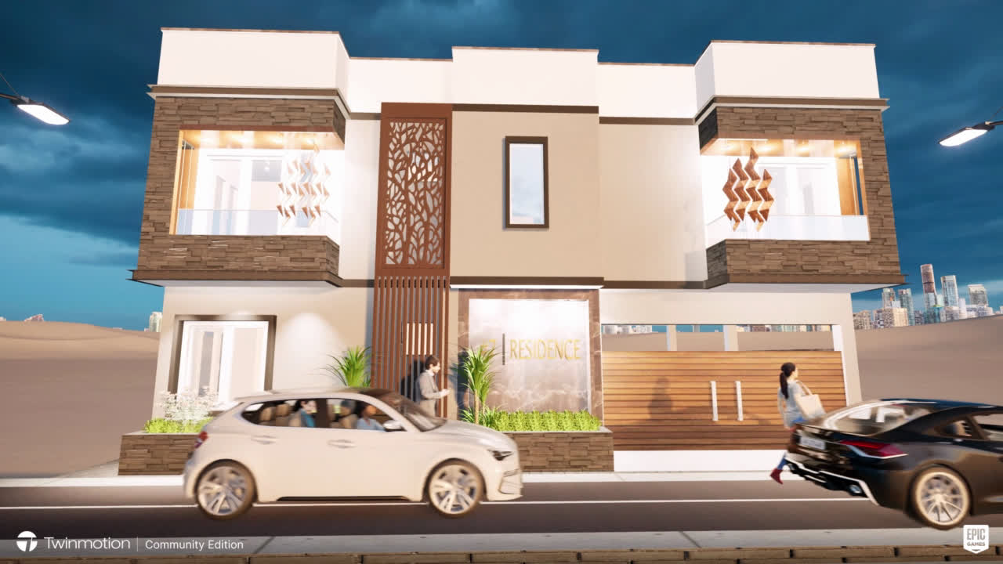
EXTERIOR ELEVATION

Slide 6
THANK YOU
That's my portfolio so far.

